Slide 1
SCeFSTA: Smart Contract Enabled Auction for Healthcare Transportation
Presented by: Suman Bhunia

Slide 2

Scope of research
Healthcare Transport Sector
Blockchain Technologies
Competition through auctions
SCeFSTA

Slide 3






Use case scenario
③ Several ambulances are dispatched, resulting in waste of resources
⑤ Hospital receives patient from transport
③
③
④ One of the ambulances that arrives picks up patient
② The police / first responder calls in dispatch for ambulance
① An accident causes injury

Slide 4
Domains of HTS
Emergency
Interfacility Transport
Non
-
emergency
Medical
Services (EMS)
Medical
Transport (NEMT)
•
Most widely known domain
•
Transportation between
•
Utilized by those unable to
of HTS
healthcare facilities
provide own transportation
•
Utilized after a minor/major
•
Facilities typically contract
•
Common in nursing homes
incident
single provider
and with senior citizens
•
Incidents range from low to
•
Has two forms, ground
•
Typically used for doctor
critical acuity
transport and air transport
appointments/checkups

Slide 5
Motivation
Company Concerns
Patient Concerns
Waste of resources
Cost of transportation for patients
Funding and Billing
Communication and Patient Tracking
Staffing shortages
Lack of access to transportation

Slide 6

Proposed system
A secure sealed bid auction platform w/ blockchain technologies.
1
Creates fair competition, through auctions, between transportation companies
2
Utilizes suitable blockchain network that can provide stable and reliable prices for users.
3
Fits multiple healthcare transport sector domains based on feedback from domain experts through interviews
4
Complete user-study to assess application effectiveness.
5

Slide 7
Related works – Blockchain Auction Systems
OpenSea [11]:
Used for NFT trading
Uses smart contracts for blockchain auctions
Rarible [12]:
Utilizes both ascending auctions and descending auctions.
Popular digital marketplace using blockchain auctions

Slide 8
Related works – Blockchain in Healthcare
•
Securely store patient information
Blockchain
•
Quickly accessible to reduce
Based Record
number of pre
-
hospital deaths
Management
•
Creates continuous footprint of
[12]:
patient data using immutable
blockchain features
Blockchain
based Secure
•
Uses blockchain operations to
Ambulance
differentiate emergency vehicles
-
to
-
from ordinary vehicles
Everything
Communications
•
Creates public trust for blockchain
in emergency situations
[14]:

Slide 9

Design

Slide 10
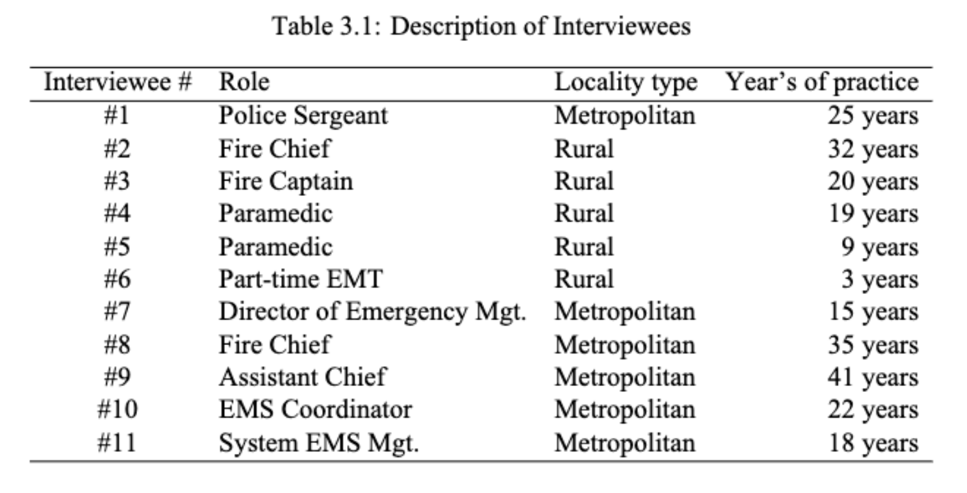
Interviewees
Performed interviews with stakeholders of our system
Designed to gather design requirements for the prototype
Utilized to find applicable domains for the application

Slide 11
design requirements

Slide 12
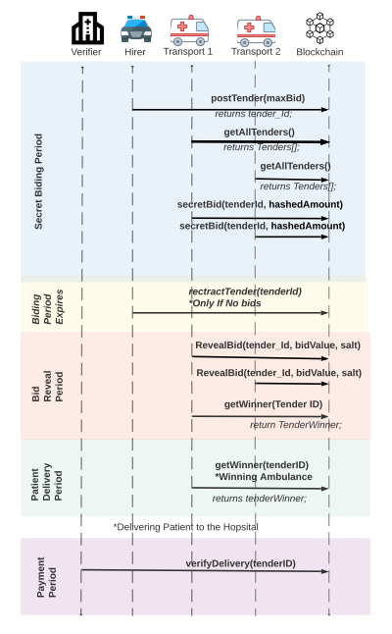





Sealed-bid auction

Slide 13

Implementation

Slide 14
Architecture design diagram

Slide 15

Video Demonstration
Note: I misspeak at 2:57 in the video. The lowest price wins the auction, so the example I give, the bidder of 40 wins, not 45

Slide 16

Evaluation

Slide 17
Estimating gas prices
Account Smart Contract
Auction Smart Contract
Fig: Gas price for Account contract under static load (500 calls)
Fig: Gas price for Auction contract under static load (100 calls)

Slide 18
API latency estimation
Account Smart Contract
Auction Smart Contract
Fig: API Latency for Account contract functions
Fig: API Latency for Account contract functions

Slide 19
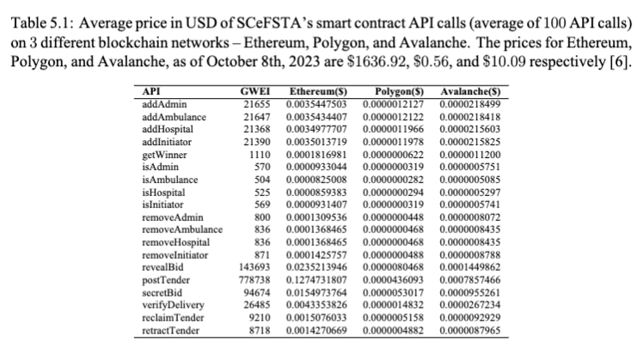
Current price estimates

Slide 20
Validation

Slide 21
Requirement validation
Created a sample quantitative question relating to each requirement:
Guaranteed payment
Resource optimization
Lower costs
Trust
Timeliness
Flexibility
Fairness
We sampled eleven Miami University students in a user-study
Presented background information about our initial interviews and design requirements
Showcased the video demonstration of the application
Then asked the quantitative questions
Each participant agreed every requirement was satisfied

Slide 22
Open feedback
We also asked qualitative questions to the users to get open-ended feedback
Aimed to elicit any concerns or potential new features
Create a notification system/auction countdown
Refine the penalty system to also include longer-lasting effects
Supply a backup vendor for failed pickup/delivery
Automatic bidding integration
Alert system for failed transports
Notes:
Penalty system: , transports who consistently perform poorly are no longer able to participate in auctions

Slide 23

Final notes

Slide 24
conclusion
Gathering domain experts in the healthcare field was very challenging
There are more features that could be added to improve user experience
Deploying the application could be more portable
The final product fit the design requirements outlined by domain experts

Slide 25
Summary
Major issues in HTS
Blockchain-based auction provides a solution
Found suitable blockchain mechanism
Generated design requirements through interviews
Implemented NextJS application
Evaluated prototype cost and API latency
Validated domain expert requirements are satisfied

Slide 26

Questions?

